Slide 1
printf(“Hello World”);
Hope you are doing alright. Welcome to THE DESIRE CAFE

Slide 2
The Desire Café
Fulfilling your desire for food
Since 1997

Slide 3
The Team
Coding
Mir Rakibuzzaman
Design & Debugging
Walid Al Habib
Hasibur Rahman
Sheikh Mohammad Abrar Jahin
Idea Implementation
Mir Rakibuzzaman (NSU ID-1812596642)
Walid Al Habib (NSU ID-1812612642)
Hasibur Rahman (NSU ID-1812046642)
Sheikh Mohammad Abrar Jahin (NSU ID-1813302642)

Slide 4
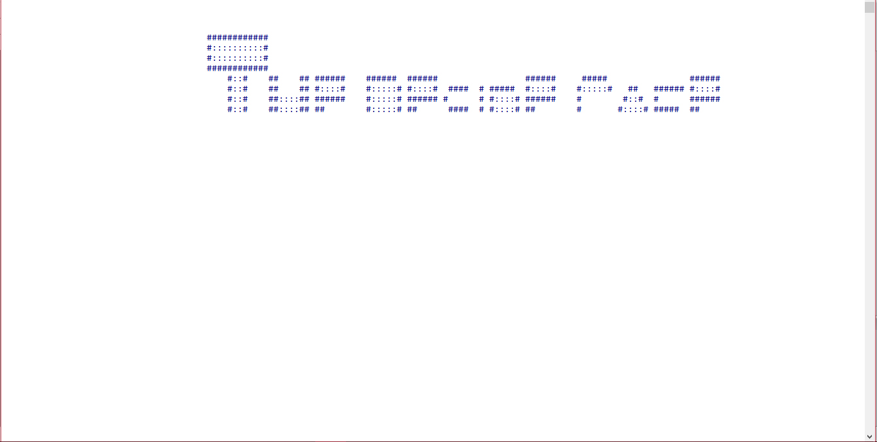
The Splash screen
The splash screen function is executed. Which shows the name of our restaurant in a cascading animation sequence.

Slide 5
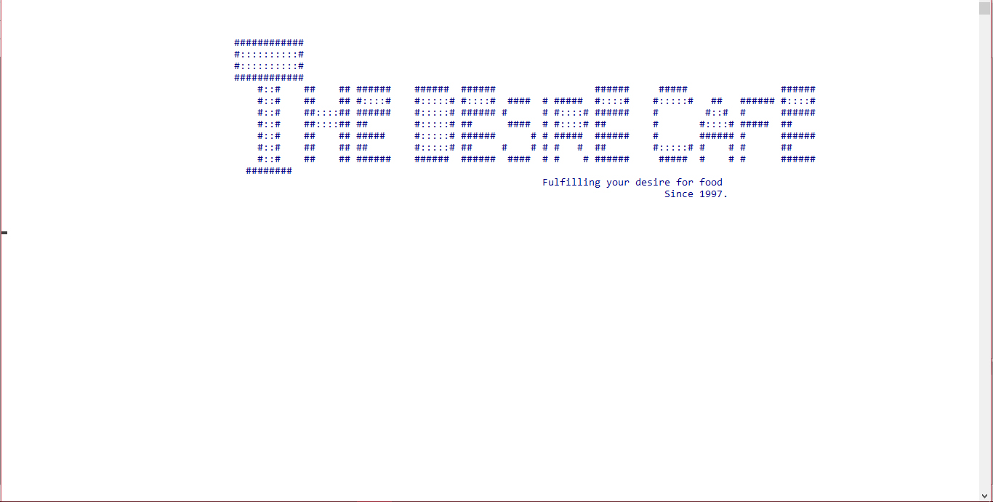
The Splash screen
The function is completed and the program is delayed for 4000 ms.

Slide 6
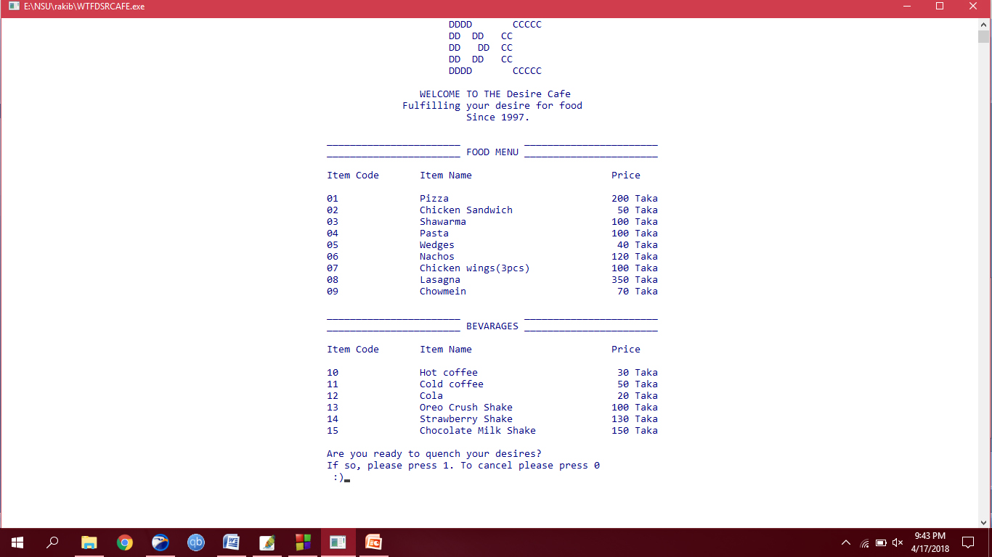
The Menu Screen
The menu is shown after the screen is cleared. And the user is asked of his/her choice of whether or not to quench his/her desires.

Slide 7
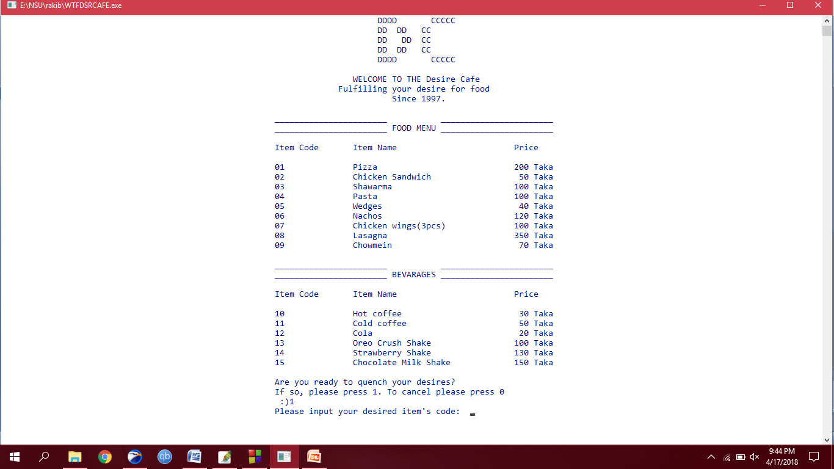
The Choice of Desire
The user is again asked to input an item code of choice provided that he/she has chosen to quench his/her desires.

Slide 8
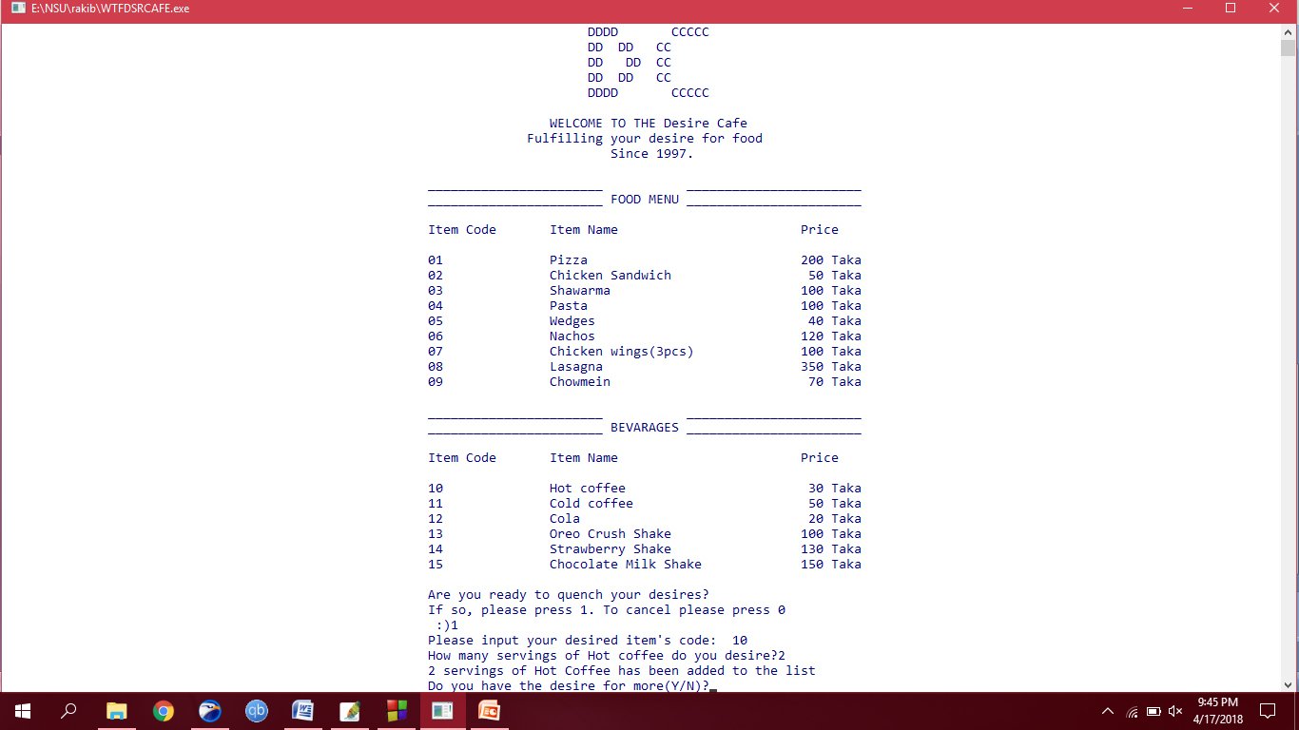
More Desire
The user has input the item code ‘10’ for hot coffee. And required 2 servings of hot coffee. After which he/she is asked whether or not he/she has the desire for more. A simple Yes or No question.

Slide 9
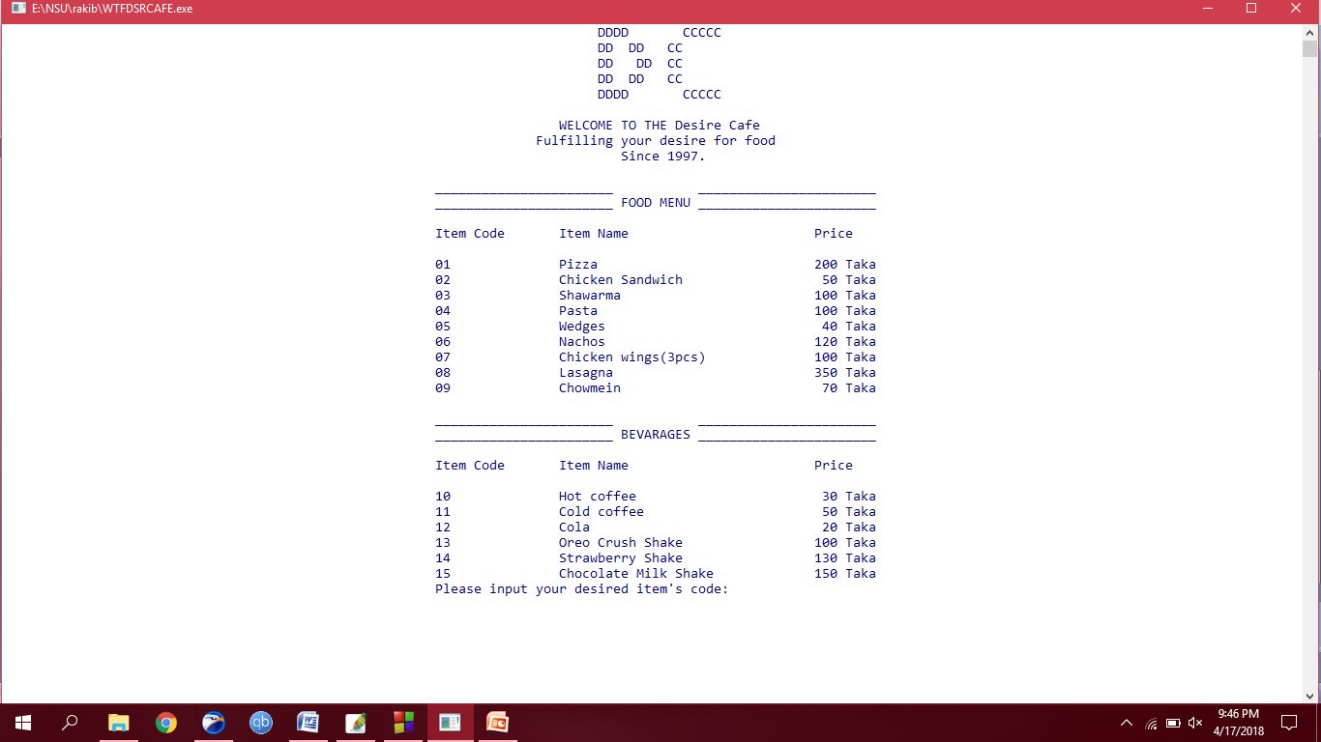
More Desire
After selecting Yes the screen is cleared and the menu is re-written.

Slide 10
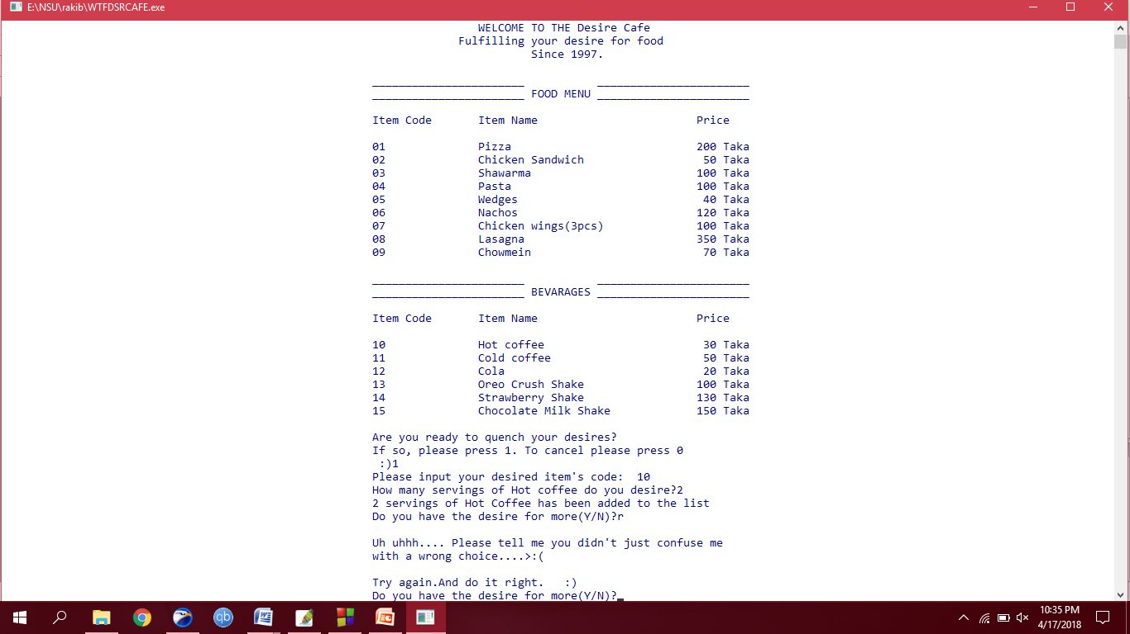
Recursion
The functions are recurred and error handling is done.

Slide 11
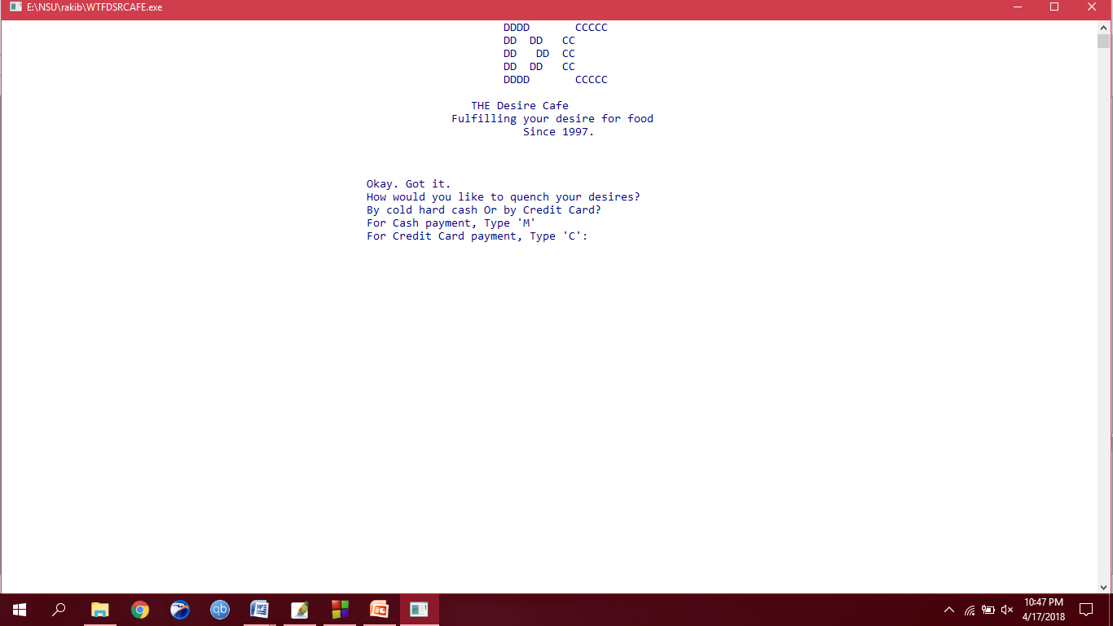
Payment Method
If Chosen no, the program asks for the users’ choice of payment in either cash or credit.

Slide 12
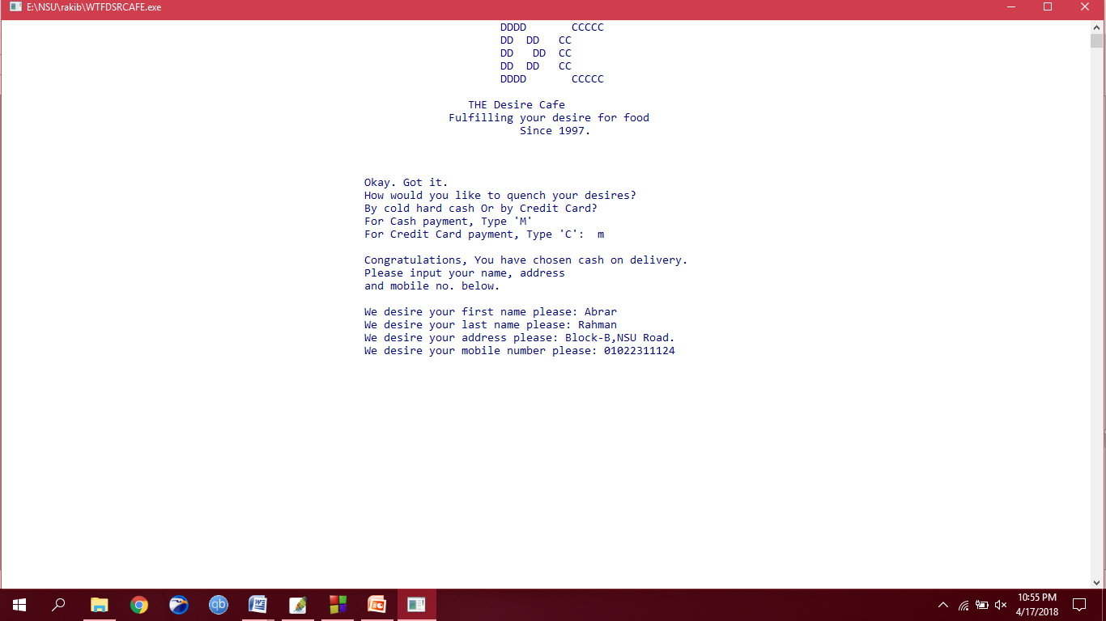
Cold Hard Cash
If the input ‘m’ the function ‘cash’ is executed. And the user is asked for his/her name, address and mobile number sequentially.

Slide 13
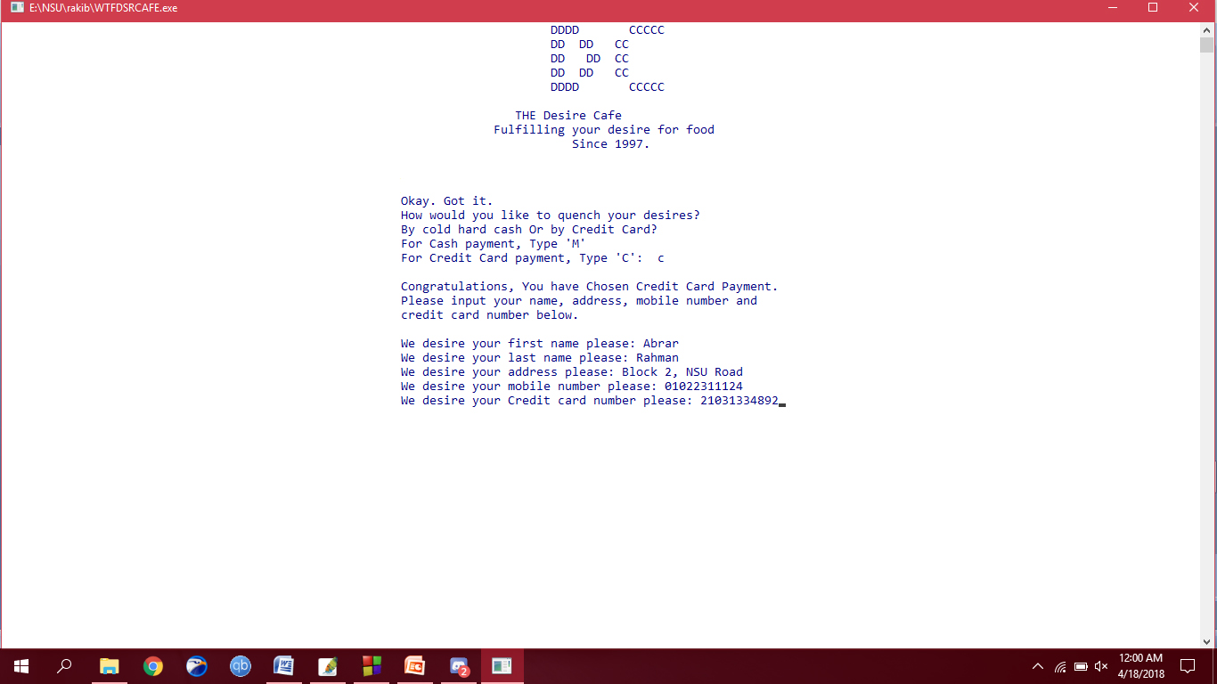
The Wonderful Credit Card payment
If the input ‘c’ the function ‘credit’ is executed. And the user is asked for his/her name, address, mobile number and credit card number sequentially.

Slide 14
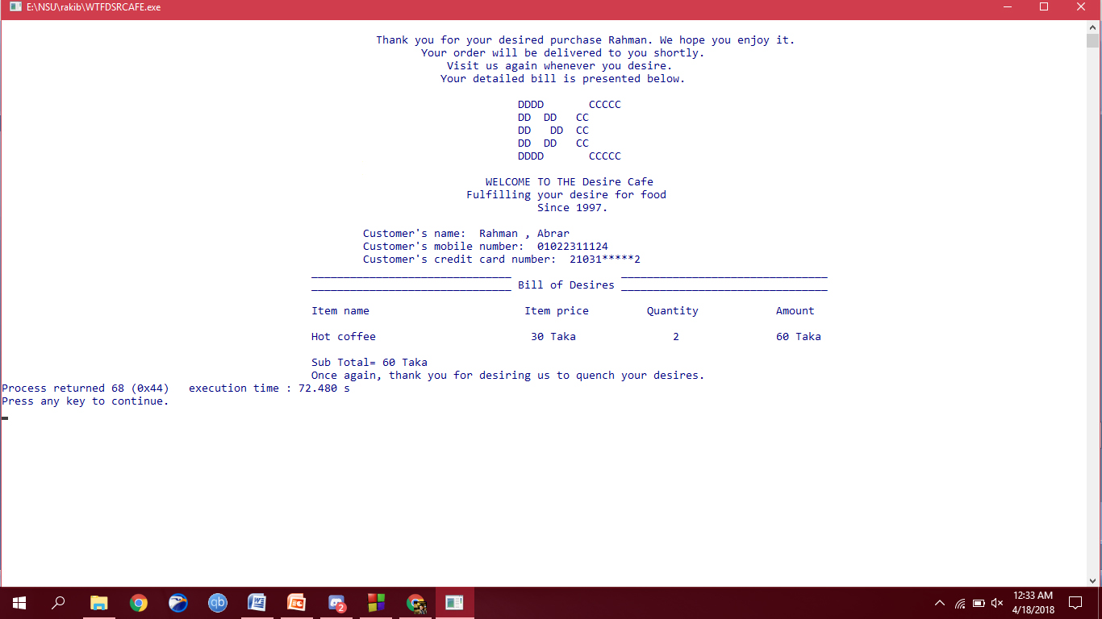
Bill Of Desires
The list function is executed here. The details of purchase and the customer’s details are shown. Notice that extra sensitive information like the customer’s address isn’t shown. Or like the credit card number, which is partially shown.

Slide 15
The End.
Thank you everyone for your Desired Time.

